Slide 1
Human-Machine Interfaces for Operating a Blimp
Krebs Matthias, Ledergerber Anton
12.06.2012
Supervisors:
Javier Alonso Mora, Konrad Rudin
Notes:
Very welcome to the Bsc Thesis Presentation HMI for operating a Blimp

Slide 2
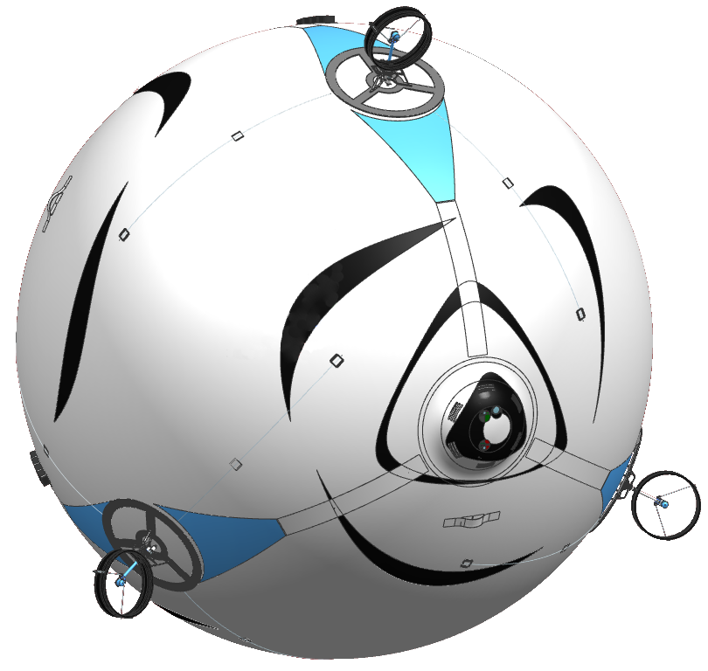
Motivation
One of skye‘s unique properties:
6 controllable degrees of freedom
Develop a unique HMI and generate Trajectories
To deal with
6 DoF
Motor Platform
Camera System
Control Unit
Accelerometer Gyroscope Magnetoscope Barometer GPS
Spherical Hull
Filled with Helium
Communication
Xbee 2.4 GHz Fasst WiFi
Notes:
We‘re sure you all know the Focusproject Skye. We did our Bsc Thesis within this project. (click) Because of skye‘s unique property of 6 controllable degrees of freedom, a good, unique HMI as well as trajectories had to be developed since humans aren‘t used to controll 6 DoF.

Slide 3
Main tasks
Develop Control Modes for 6DoF Motion
Realize HMI
Generate 3D Trajectories
Notes:
These were our main tasks: Control Modes, HMI, Trajectories. Our Presentation is divided into two parts (click), first we will discuss the control modes and the HMI together, and secondly, we will discuss the trajectory generation

Slide 4
Control Modes
Overview
Testphase
Control
Direct
Control
Assisted
Control
Half Automatic Control
Full Automatic Control
Development of Project skye
Notes:
As we started from zero, we couldn‘t start with the most advanced Control Mode for steering. Instead we offered a control mode for each stage of the project, adopted at the hard- and software that was ready. In the following the different modes and their implementations are explained.

Slide 5
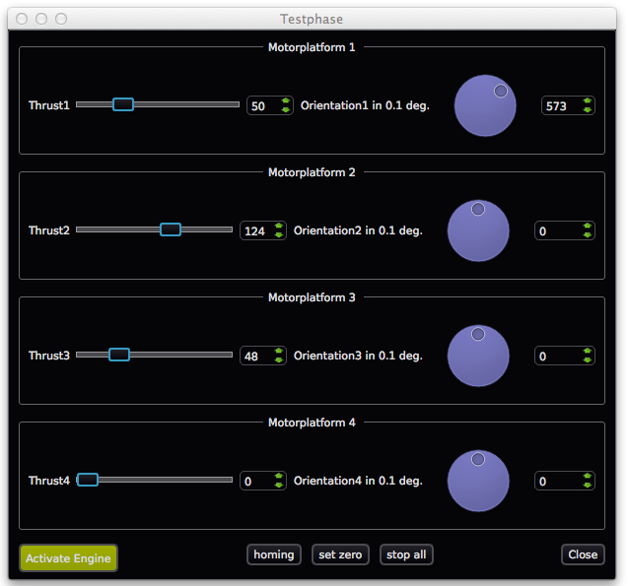
Control Modes
Testphase
✔
Tested on real
system
8 DoF (Angles, Thrust)
Only for testing
Each Motorplatform is controlled seperately
Notes:
The first step was to control each motor seperately. Skye has 4 maxons for positioning and for brushless motor for generating the thrust. Once we knew that this mode was working, we could be sure that the hardware was ok. (Here we just offered a simple Widget.) (click) (this mode is tested and working) The next thing to attack was the software....

Slide 6
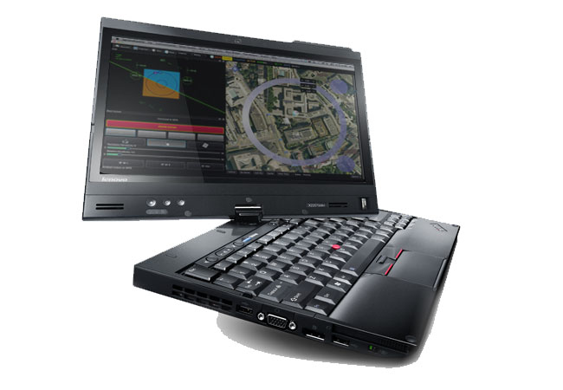
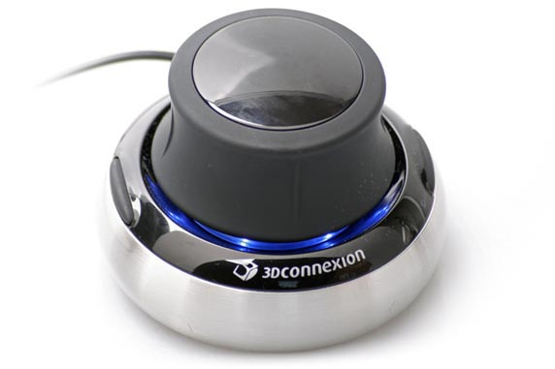
Control Modes
Direct Control
✔
Tested on real
system
6 DoF (Forces, Moments)
Without Controller
Notes:
DC Mode is simple a feedforward control for all 6Dof, i. e. the moments and the forces. This mode was useful to test the motor allocation without a (high level controler) Most inuitive is to use a 3d space mouse for that. Therefore a interface to QGC was developed with which the 3d mouse could be attached. (click) this is tested and working on the real system.

Slide 7
Control Modes
Assisted Control
6 DoF (Velocities)
With Controller
Notes:
Once the (high level) controler with feedback was working, we didn‘t want to control skye with forces, but with velocities. Beside the space mouse, a GUI for touchinputs was also wished, here you see it in action. (click) The idea was to control the translational velocities in the inertial frame and the rotational velocities in the body frame. Due to problems with the drift of the magnetoscop and the GPS or the state estimation in general, (click) we only tested it with all inputs in the body frame.

Slide 8

Control Modes
Assisted Control
Notes:
Once the (high level) controler with feedback was working, we didn‘t want to control skye with forces, but with velocities. Beside the space mouse, a GUI for touchinputs was also wished, here you see it in action. (click) The idea was to control the translational velocities in the inertial frame and the rotational velocities in the body frame. Due to problems with the drift of the magnetoscop and the GPS or the state estimation in general, (click) we only tested it with all inputs in the body frame.

Slide 9
Control Modes
Half Automatic Control
3 manual DoF (Rotational Velocities)
With Trajectory Controller for translational velocities
Pilot controls attitude for taking pictures
Notes:
In order to ease the job of the pilot 3 Dof should be controled automatically. Before the flight the pilot would set the waypoints on google map and afterwards only control the orientation. This mode was thought best for taking high quality images. Here you see a simulation of this mode(click) (click) only tested in simulation since GPS was not yet working.

Slide 10
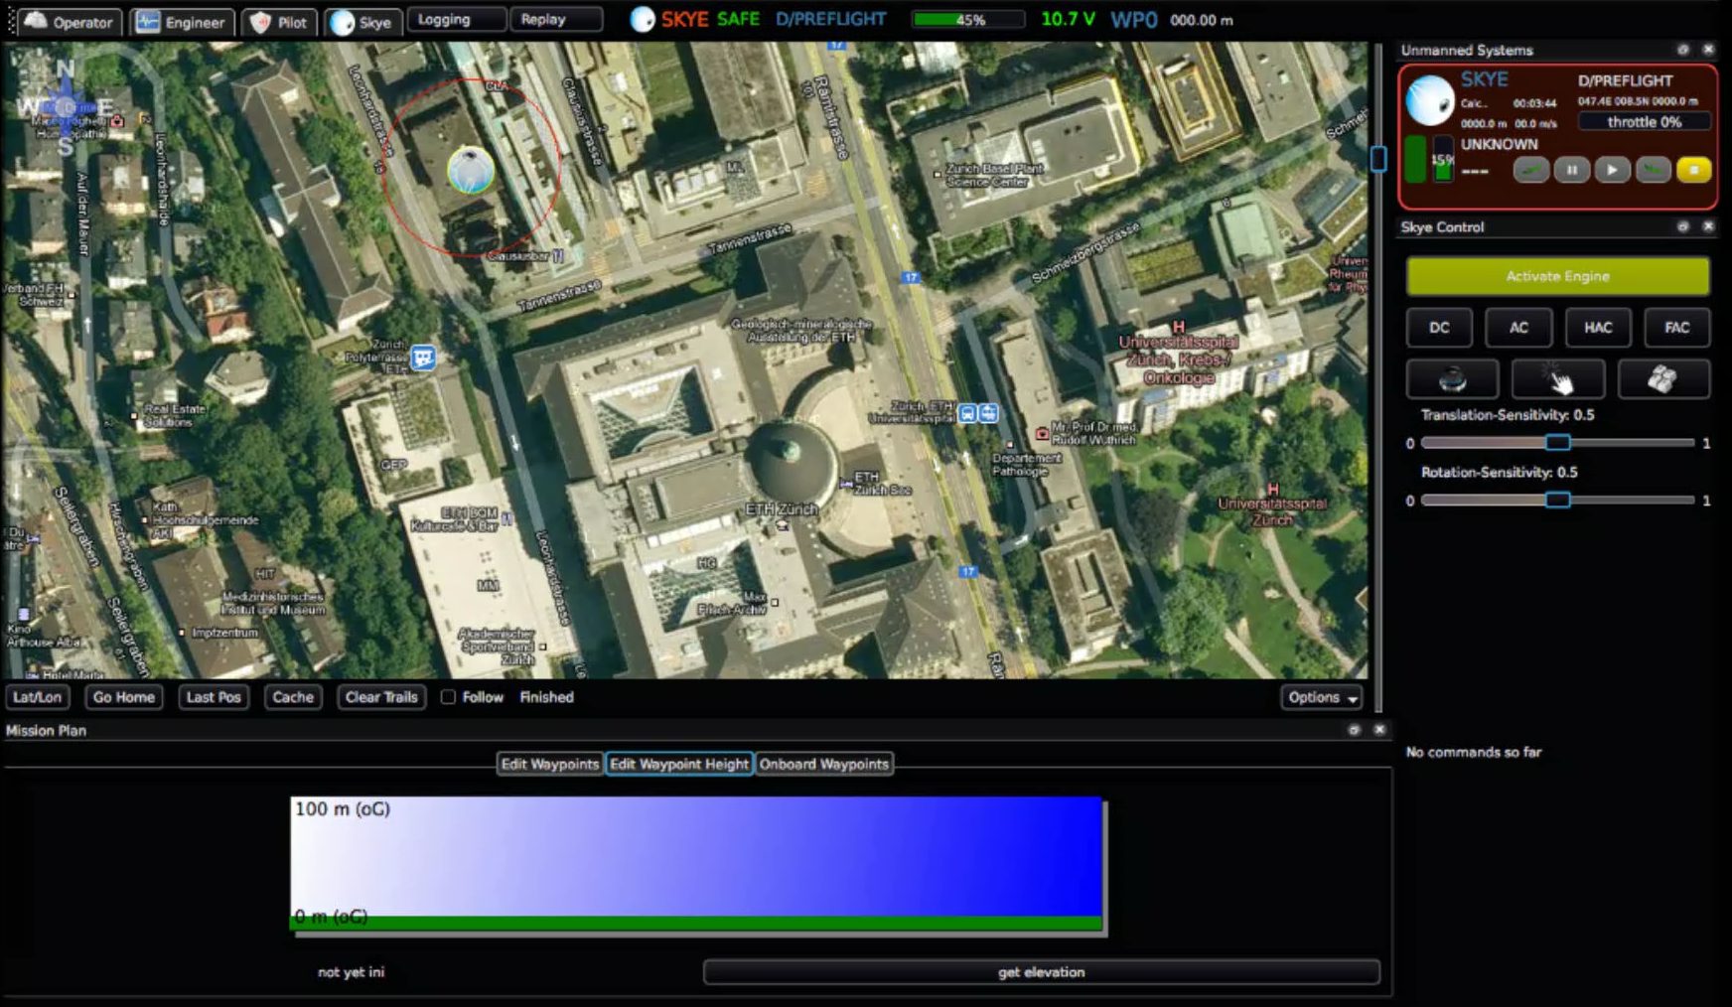
Control Modes
Half Automatic Control
✔
Tested in QGC
Simulation

Slide 11
Control Modes
Full Automatic Control
✔
Tested in
Matlab
Simulation
To appear Video of Simulation
0 manual DoF
With Trajectory Controller
With set Target Point
Full Automatic

Slide 12
Path/Trajectory
Body Frame
Inertial Frame

Slide 13
Approximation/Interpolation

Slide 14
Spline Degree
Continuity
-cubic
-quartic
-quintic

Slide 15
Spline Degree – Prop. Dynamic
Simulation
C² seems to be sufficient!
C³ Continuity would be best!
Decision
Consider the other effects of the spline degree choice, if quartic has no drawbacks, choose quartic.

Slide 16
Parameterization
Motion Law
The decision of parameterization affects the geometry as well as the velocity and acceleration on the trajectory!

Slide 17
Parameterization
Variants
Equally-distant
Chord-distant
Arc-distant
Centripetal

Slide 18
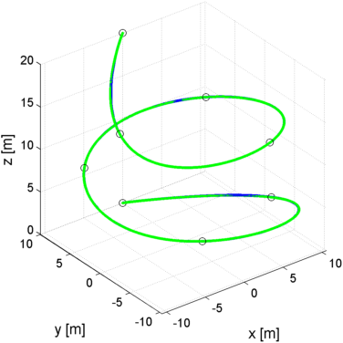
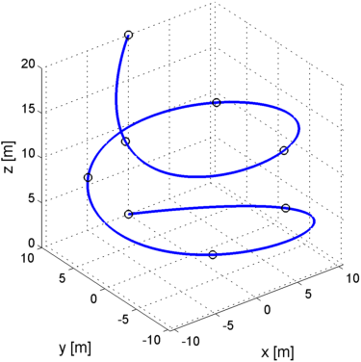
Trajectory-Controllers
Criteria
Precise path tracking
Low power consumption
Time equivalence (trajectory tracking)
Trajectory p(t)
Trajectory Simulation Trace r(t)
Notes:
For an estimate how skye would act on the trajectories, we tested it based on the simulation built by two further BSc Thesisss. We have the blue trajectory as reference p(t) and compare it with the trace of skye r(t).
There are three criteria that have to be minimum for a good tracking: The average distance between the PATH and the TRACE, the average ACCELERATION of skye that means minimum power consumption as well as time synchronity.

Slide 19
Trajectory-Control
Controllers
3 different approaches: Trajectory Following Pure Pursuit Cross Track
(Lookahead) (Closest Point)
Trajectory
Pos Control
Skye
Skye
Notes:
Based on the Controller designed by Gian, we set up 3 usually used trajectory controllers.
The first approach is based on fully known system constraints. If the trajectory is within these limits, it is possible to feed in the reference state p(t) for every timestap. [RUN]

Slide 20
Trajectory-Control
Controllers
3 different approaches: Trajectory Following Pure Pursuit Cross Track
(Lookahead) (Closest Point)
Trajectory
Vel Control
Skye
Skye
Notes:
PURE-PURSUIT is based on a Lookahead point. We look for the closest point of the trajectory to the actual position and then head for a lookahead point. The time synchronity is not guaranteed, but the controller is much more robust.

Slide 21
Trajectory-Control
Controllers
3 different approaches: Trajectory Following Pure Pursuit Cross Track
(Lookahead) (Closest Point)
Trajectory
Pos Control
Skye
Skye
Notes:
Finally, CROSS-TRACK ERROR CONTROL works the same way than TRAJECTORY FOLLOWING except that we don‘t persist(?) on time synchronity but always check for the closest point on the trajectory.

Slide 22
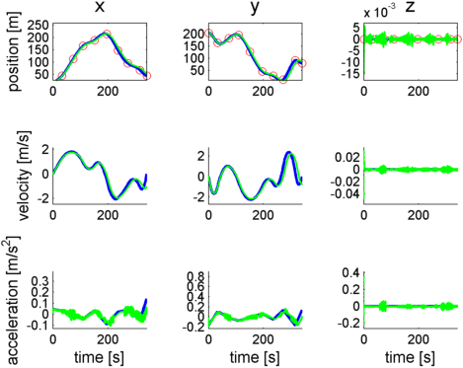
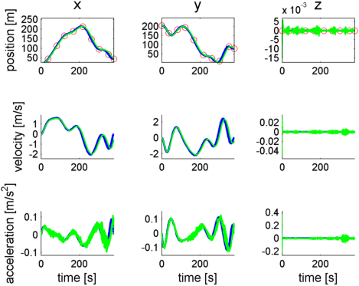
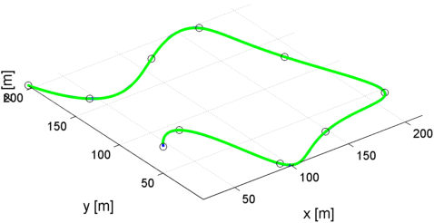
Evaluation
Absolut Results
J1: Average Deviation 0.01 m
J2: Average Acceleration 0.1 m/s²
J3: Used Time +/- 5%
cubic
quinic

Slide 23
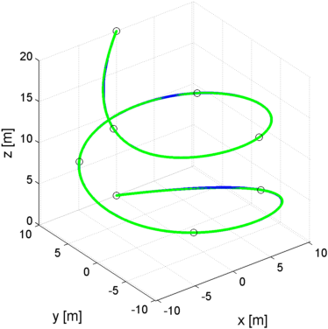
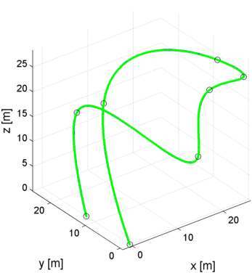
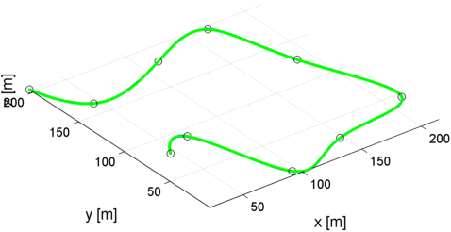
Evaluation
Different Waypoints
Path1
Path2
Path3
„ETH mainbuilding“ „Helix around tree“ „Agil maneuver“

Slide 24
Evaluation
Performance
Trajectoy Following
Pure Pursuit
Cross Track
Path1
Path2
Path3
Quintic
Quartic
Cubic
No wind, centripetal param.
J1: Average Deviation
J2: Average Acceleration
J3: Time (always exact)

Slide 25
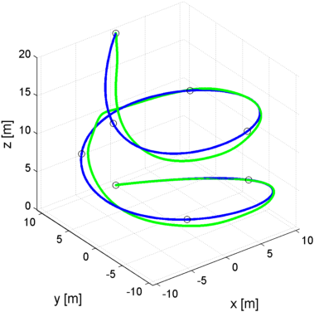
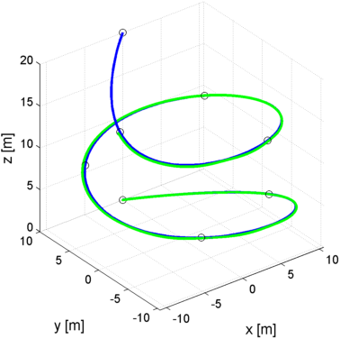
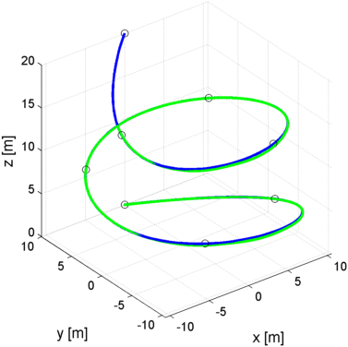
Evaluation
Performance
Trajectoy Following
Pure Pursuit
Cross Track
Path1
Path2
Path3
Quintic
Quartic
Cubic
Wind 1m/s, centripetal param.
J1: Average Deviation
J2: Average Acceleration
J3: Time (85-90%)

Slide 26
Evaluation
Performance
Trajectoy Following
Pure Pursuit
Cross Track
Path1
Path2
Path3
Quintic
Quartic
Cubic
Wind 1m/s, centripetal param.
J1: Average Deviation
J2: Average Acceleration
J3: Time (85-90%)

Slide 27
Evaluation
Performance
Trajectoy Following
Pure Pursuit
Cross Track
Path1
Path2
Path3
Quintic
Quartic
Cubic
Wind 1m/s, centripetal param.
J1: Average Deviation
J2: Average Acceleration
J3: Time 85-90%)

Slide 28
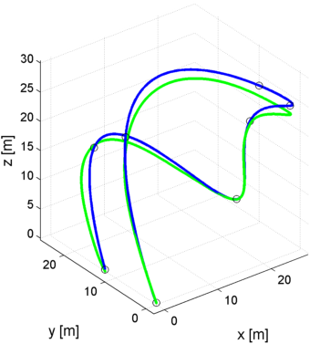
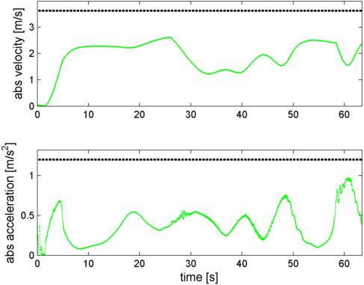
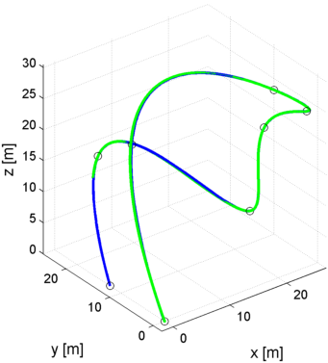
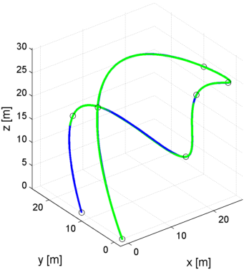
Evaluation
Model uncertainties
Trajectoy Following
Pure Pursuit
Cross Track
Deviation: 0.010m » 0.849m 0.014m » 0.041m 0.006m » 0.069m
Acceleration: 0.114 » 0.2389 0.1099 » 0.1807 0.1088 » 0.1879

Slide 29
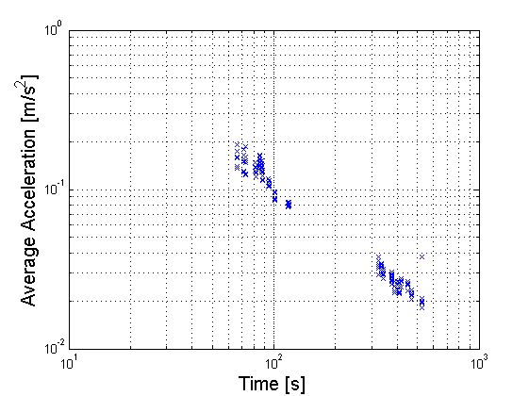
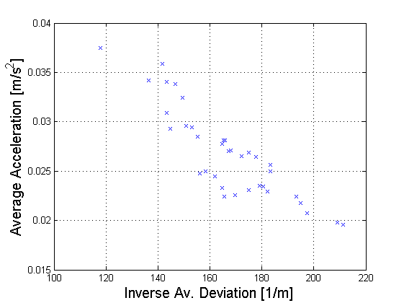
Evaluation
Correlation
The faster the way, the higher the accelerations
Either acceleration or deviation will be big
Equally-distant
Chord-distant
Arc-distant
Centripetal
cubic
quartic
quintic

Slide 30
Conclusion
Working HMI
Choice for Trajectory
✔
Cubic
Centripetal?
CrossTrack?

Slide 31
>> Backup

Slide 32
Spline Degree
Motor Allocation
Unrealistic Circuit (20cmx40cmx0cm)
unlike Quadrocopters skye is very inert =>Motion Law prevents it from fast movements
The motor Allocation seems to be able to catch up easily with the dynamics of Skye

Slide 33
Parameterization
Cubic:

Slide 34
Evaluation
Correlation
Equally-distant
Chord-distant
Arc-distant
Centripetal
cubic
quartic
quintic

Slide 35
Evaluation
Correlation
Equally-distant
Chord-distant
Arc-distant
Centripetal
cubic
quartic
quintic
Road only

Slide 36
Evaluation
Correlation
Equally-distant
Chord-distant
Arc-distant
Centripetal
cubic
quartic
quintic

